Slide 1
Are
You
Ready?
CCAR January 2025 Tech Rally

Slide 2
Deployment Scenarios
Individual
Shelters
Nuclear Power Plant
  Exercises
  Actual
Public Service
  Canoe Challenge
  French Creek Iron Tour

Slide 3
Communications Needs
Voice
Digital
Formal Messages

Slide 4
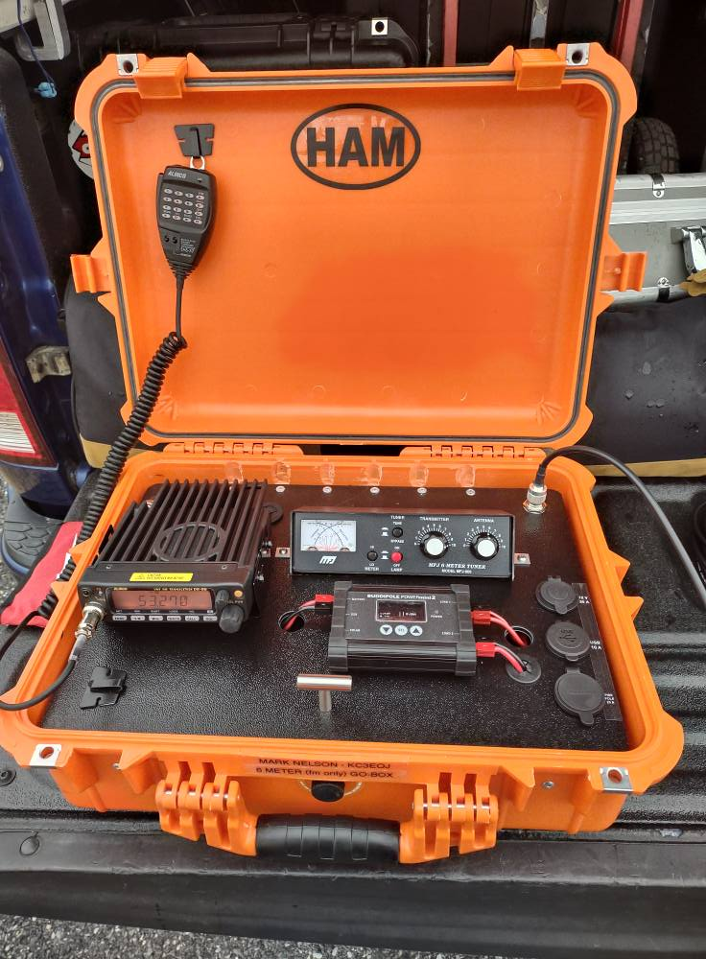
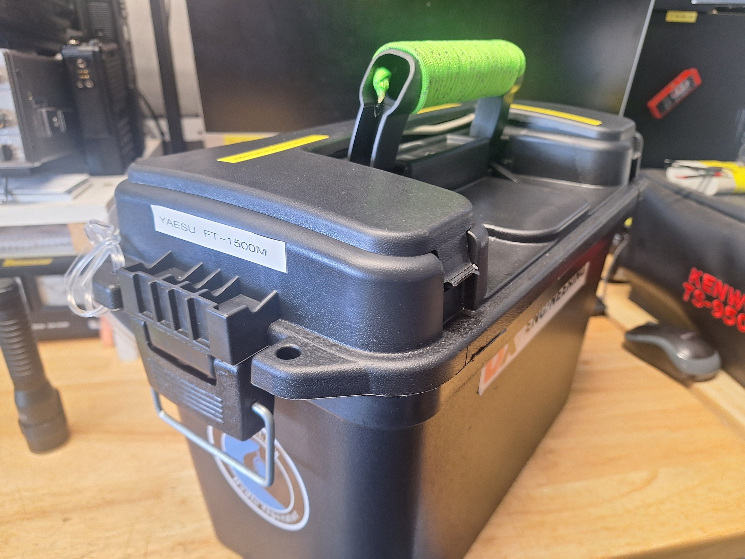
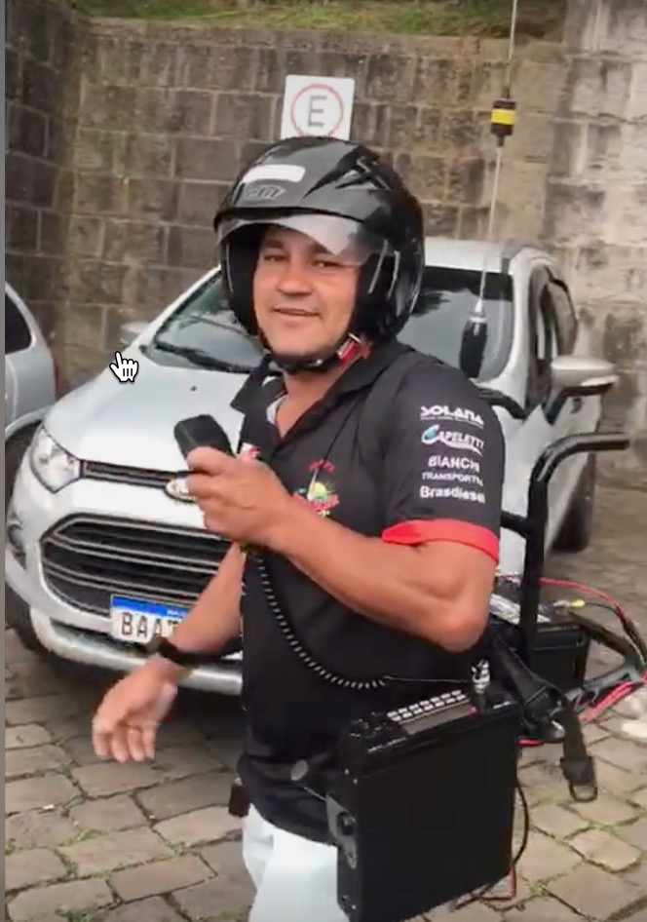
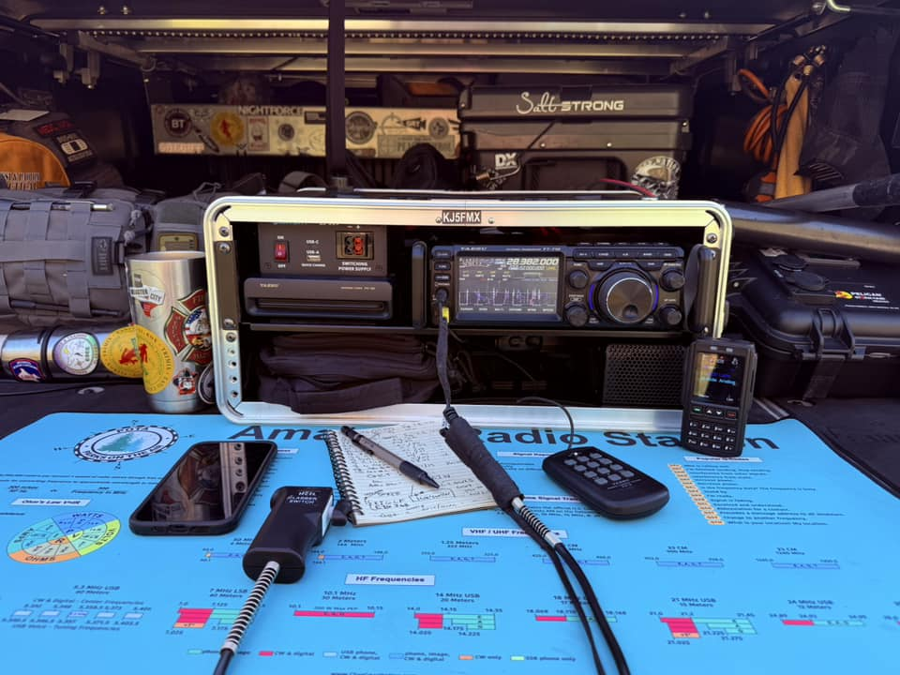
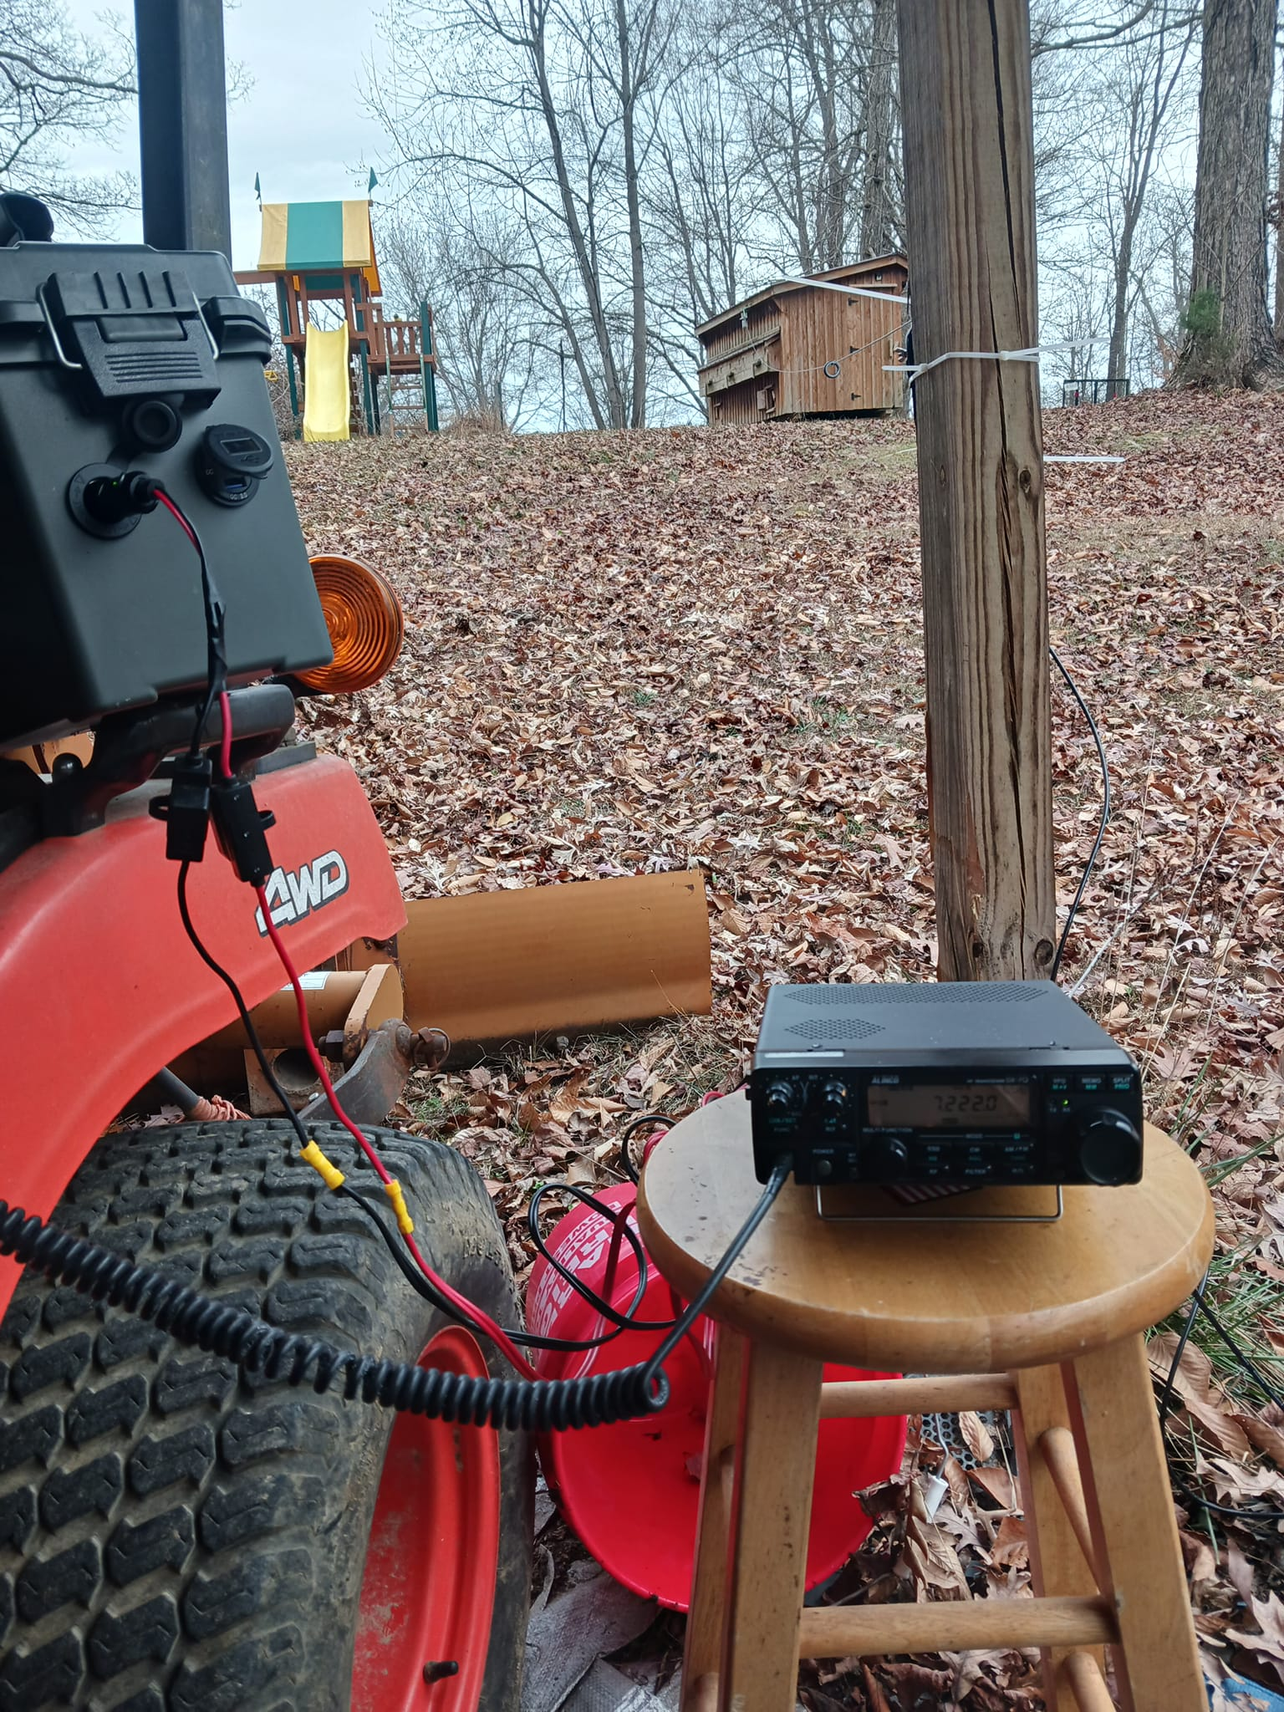
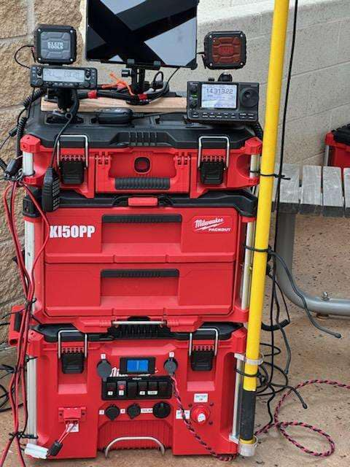
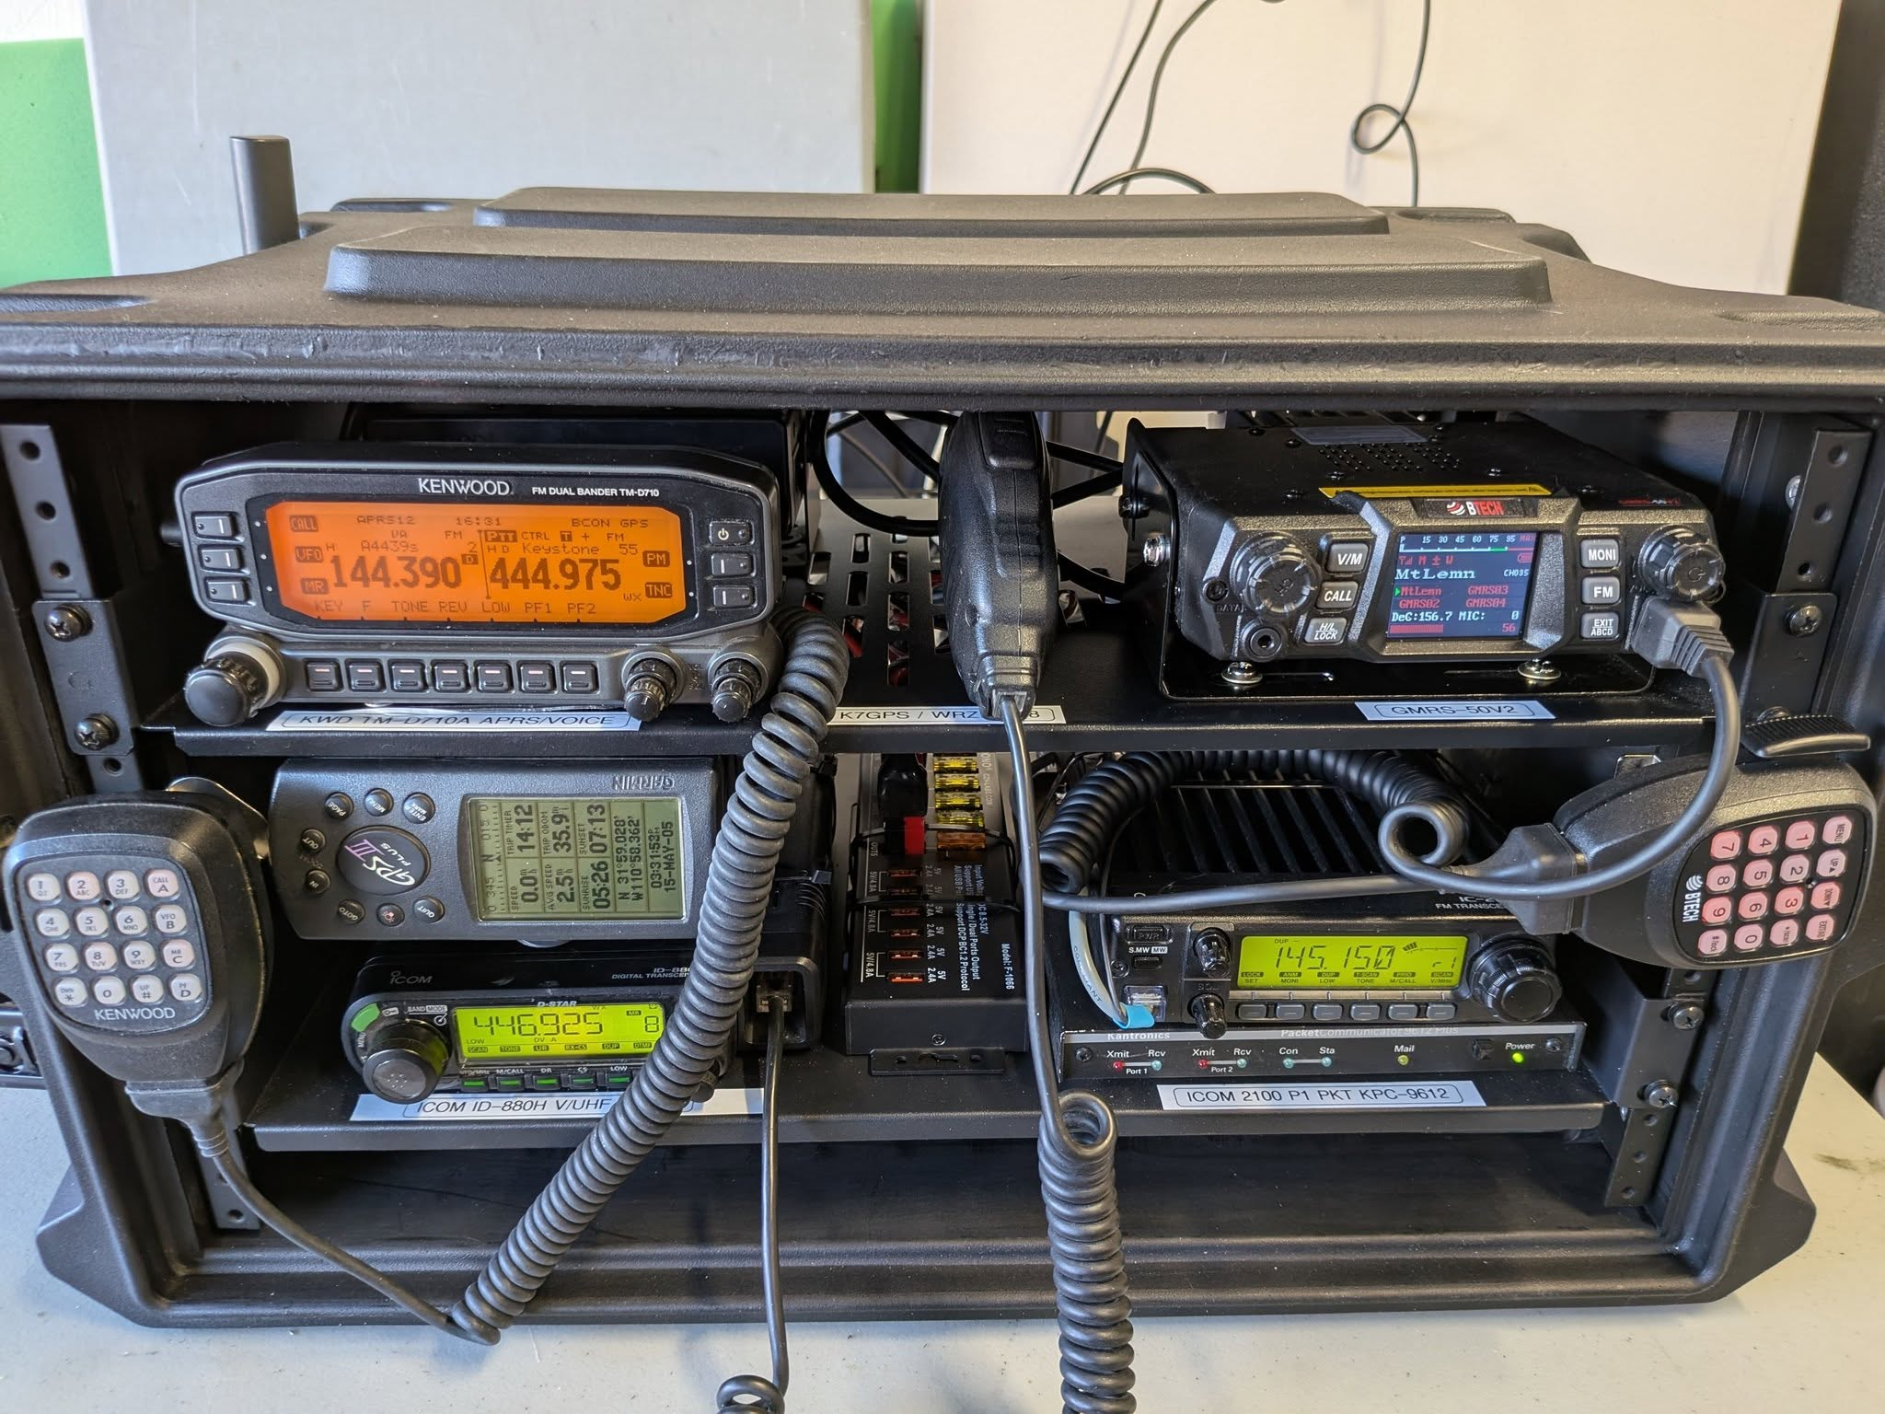
Go-Kits
What is it?
What should it contain?

Slide 6
Go-Kit Types
Deployment Length
  12/24/48+ Hours
Voice only
Voice & Digital

Slide 7
Radios
Portable/Mobile
  Recommendations
Handheld
  Recommendations

Slide 8
Radios – Portable/Mobile
Higher power
  25 watt+
External 12VDC powered
Dual-band
External antenna
Best for data modes
  NBEMS
  VARA/Winlink
Data connector highly recommended
  Dual-band operation simultaneously recommended

Slide 9
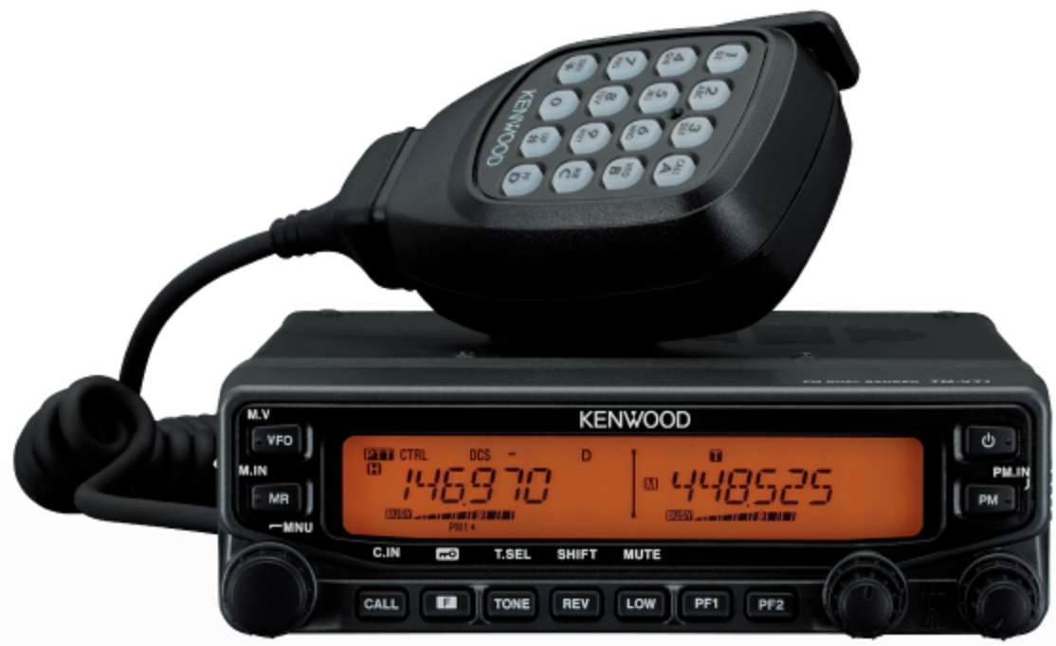
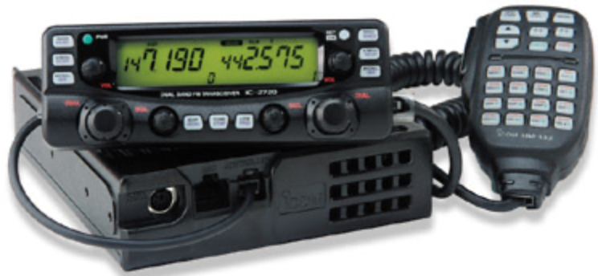
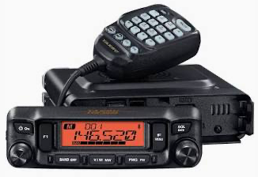
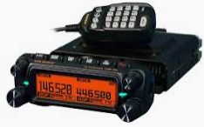
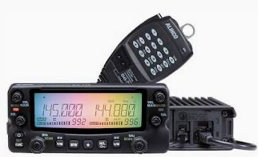
Portable/Mobile Radio - Recommendations
Mainstream suppliers best
Older
  Kenwood TM-V71A
  Icom IC-2720H
Newer
  Yaesu
    FTM-600R (~$280)
    FTM-150R (~$380)
  Alinco DR-735T (~$340)
Headset beneficial

Slide 10
Radios - Handheld
Lower power
  Typically 5 watts
Internal battery powered
Antenna mounted on radio
Great for quick deployment
Not well suited for data modes
  Suggest only as backup

Slide 11
Handheld Radios - Recommendations
Mainstream suppliers best
  Icom
  Kenwood
  Yaesu
Should have extra batteries
  “AA” module nice
Speaker/microphone
  Earbud beneficial

Slide 12
Power Sources
A.C.
Battery
  Rig
    Mobile
    Handheld
  Computer
  Accessories

Slide 13
Antennas
Already in place
Bring your own
  Magnetic mount
    Ground plane
  J-Pole

Slide 14
Other Items
Forms
Paper & Pencil
Badge
Laptop
  Power, cables, etc.

Slide 15
Responsibilities
Communicate
Communicate
Communicate

Slide 16
Safety
Take care of your family and yourself first!

Slide 17
Miscellaneous
Weather Stations
Skywarn reporting
Home preparedness
  Emergency Power
  Food/water
  Radios/antennas

Slide 18

Show and Tell

Slide 19
Show and Tell

Slide 20
Questions?

Slide 21
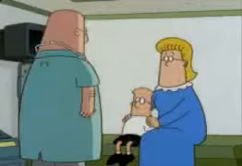
The Knack

